Slide 1
Bazinga
Melissa Gamboa Naranjo
Carlos Sanchez Viquez
Julia Cascante Salazar

Slide 2
Final Project :
[Problem]
The model does not consider mask effectiveness.
[Intervention]
Mask effectiveness
Infection rate depends on mask type
N95, surgical mask, gauze, silk, etc.
[Goal(s)]
Analyze the reduction of infection considering different types of masks.

Slide 3
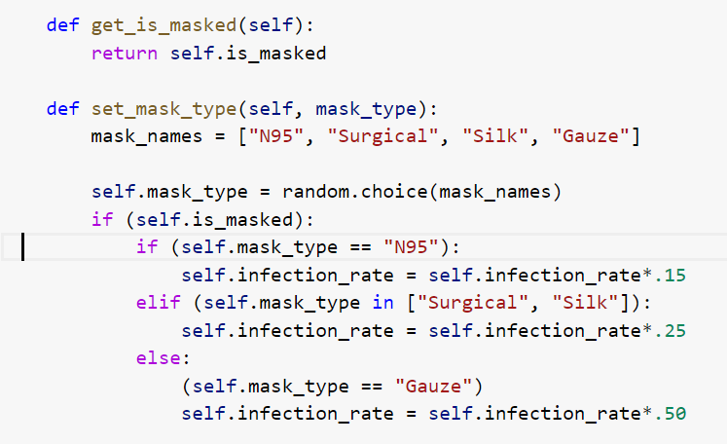
Defining the type of mask will change the infection rate.

